Slide 2
Learn about data ingestion
Learn about uploading data

Slide 3
Introduction
Data ingestion in Splunk happens through the Add Data feature which is part of the search and reporting app. After logging in, the Splunk interface home screen shows the Add Data icon

Slide 4
Introduction
About uploading data
When you add data to your Splunk deployment, the data is processed and transformed into a series of individual events that you can view, search, and analyze

Slide 5
Introduction
What kind of data?
Data source
Files and directories
Network events
IT Operations
Cloud services
Database services
Security services
Virtualization services
Application servers
Windows sources
Other sources

Slide 6
Where is the data stored?
The process of transforming the data is called indexing.
During indexing, the incoming data is processed to enable fast searching and analysis. The processed results are stored in the index as events.
The index is a flat file repository for the data. The index resides on the computer where you access your Splunk deployment.

Slide 7
Where is the data stored?
Events are stored in the index as a group of files that fall into two categories:
Raw data
Index files

Slide 8
Where is the data stored?
Buckets
Main
Splunk Instance

Slide 9
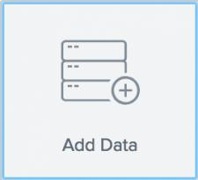
Use the Add Data wizard
If there is a Welcome window displayed, close that window.
Click Settings > Add Data.

Slide 10
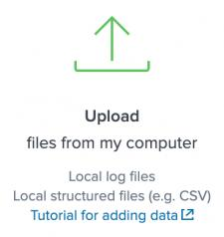
Use the Add Data wizard
At the bottom of the window, click Upload. There are other options for adding data, but for this tutorial you will upload the data files.

Slide 11
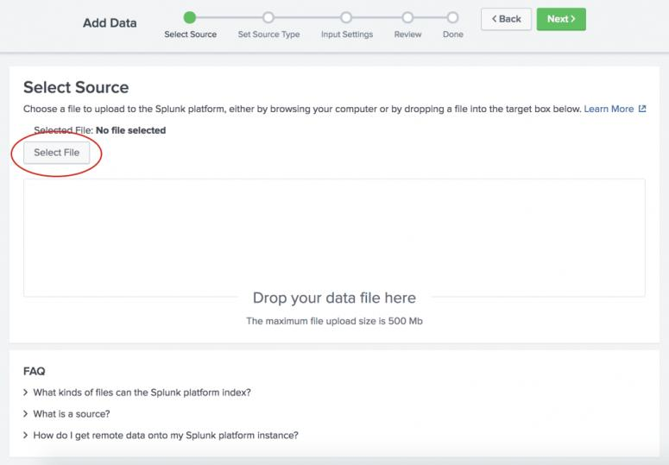
Use the Add Data wizard
Under Select Source, click Select File..

Slide 12
Use the Add Data wizard
In your download directory, select zip file and click Open.
Click Next to continue to Input Settings.
Under Input Settings, you can override the default settings for Host, Source type, and Index.
Because this tutorial uses a ZIP file, you are going to modify the Host setting to assign the host values by using a portion of the path name for the files included in the ZIP file. The setting that you specify depends whether you are using Splunk Cloud or Splunk Enterprise, and on the operating system that you are using.

Slide 13
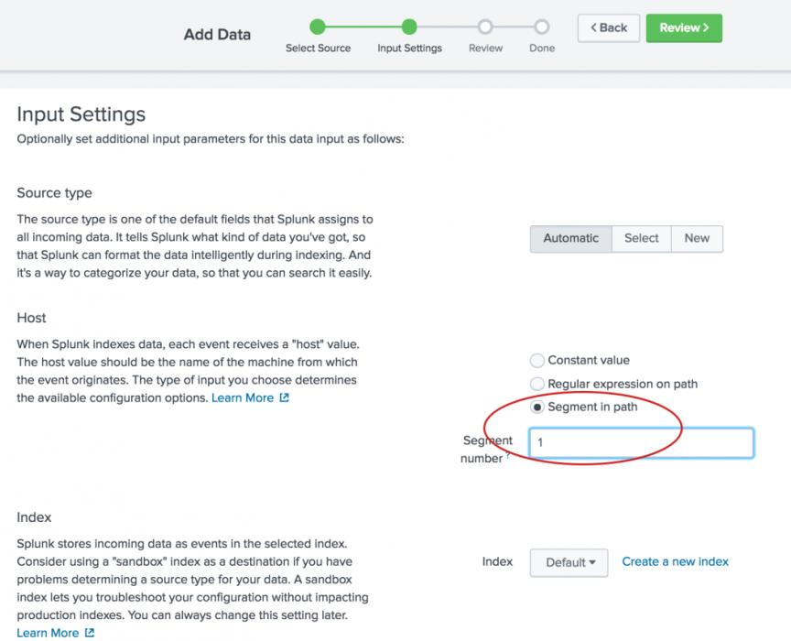
Use the Add Data wizard

Slide 14
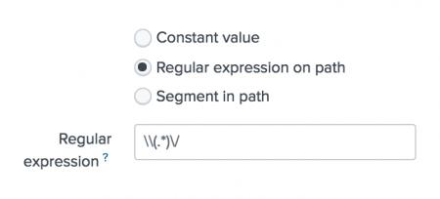
Use the Add Data wizard
a. Select Regular expression on path.
b. Type \\(.*)\/ for the regex to extract the host values from the path.

Slide 15
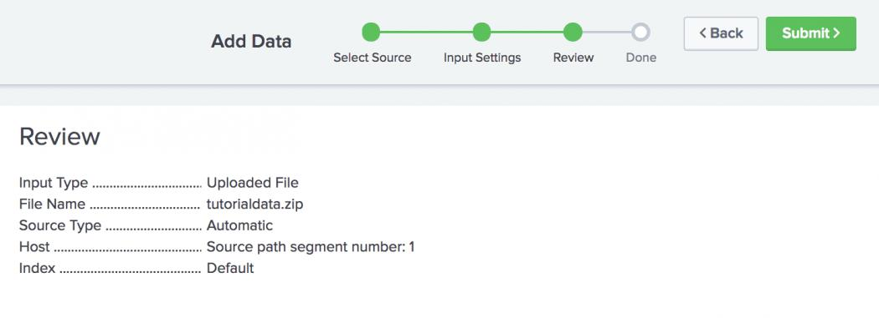
Use the Add Data wizard
Click Review. The following screen appears where you can review your input settings.

Slide 16
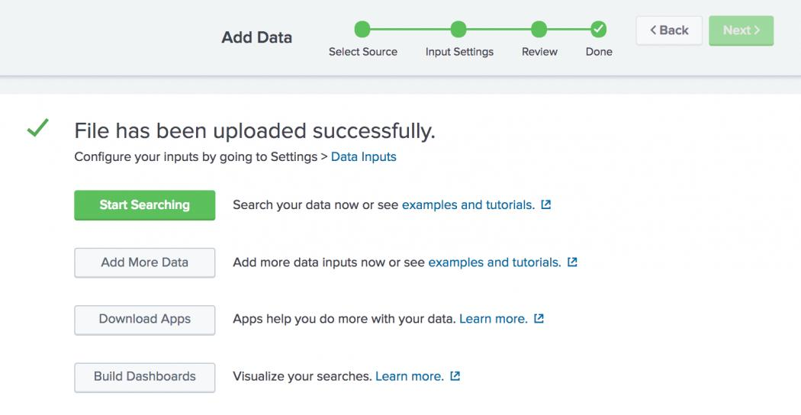
Use the Add Data wizard
Click Submit to add the data.

Slide 17
Splunk cloud
To see the data in the Search app, click Start Searching.
You might see a screen asking if you want to take a tour. You can take the tour or click Skip.
The Search app opens and a search is automatically run on the tutorial data source.

Slide 18
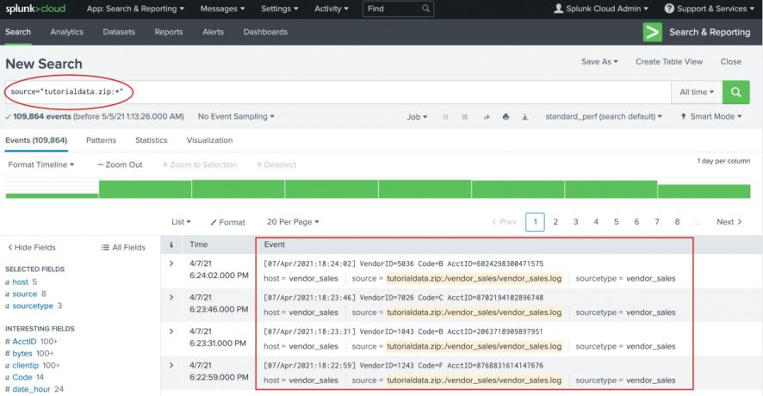
Splunk cloud
To see the data in the Search app, click Start Searching.
You might see a screen asking if you want to take a tour. You can take the tour or click Skip.
The Search app opens and a search is automatically run on the tutorial data source

Slide 19
Splunk cloud
Success! The results confirm that the data in zip file was indexed and that events were created.
Click the Splunk logo to return to Splunk Home.

